Slide 1
NYC Property Sales
Data analysis
IST 718 Group 11
Team members: Chaoying Lyu
Hong Zhu
Ruiwei Zhang
Ziyan Zhou

Slide 2
Agenda
Goal: Find ways to calculate property sale price with property features as a reference for buyers and sellers when they are trading property.
Questions of interest:
Find the most important factor on the sale price for all house sales.
Distinguish the differences in the most influential factor on house prices in different places
Verify if there’s a gap between small-size and large-size houses in sale price’s factors
Find the differences in factors on sale prices between residential and commercial units
Check if the building class may affect the sale price factors.

Slide 3
Purpose of each task
Spot trends in the property market, in association with affairs in 2016 and 2017 which may have effect on property sales.(Chaoying)
Predict the locations where the property sales price or price per sq.ft. is highest or lowest.(Chaoying)
Predict which neighborhood may have relatively new or old property for reference for buyers who have preference on property age.(Ruiwei)
Predict sale price of different building class. (Hong)
Build different models, like Linear Regression, Random Forest, GBT .etc, to predict sale price and compare the models using appropriate metrics to find the best model.(Ruiwei, Ziyan)

Slide 4

Data overview
Record of every building or building unit (apartment, etc.) sold in New York City over a 12-month period from September 2016 to September 2017.
84548 rows and 22 columns (location, address, type, sales price and sales date...)

Slide 5
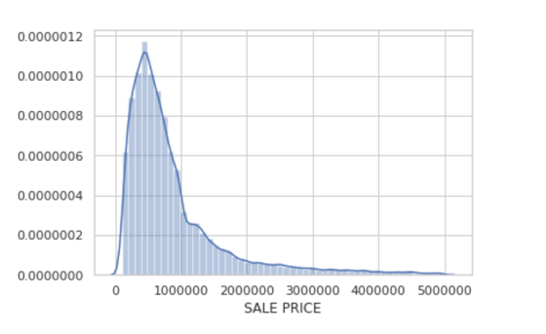
Data overview
Distribution of sale price
After removing outliers, we can find that the sale price of the property in New York City between 2016 and 2017 shows right-skewed distribution.

Slide 6
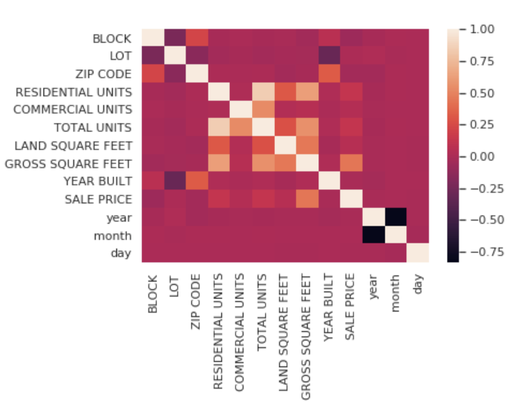
Data overview
The correlation with price:
Total unit
Years build
Gross square feet
Attributes Correlation Matrix

Slide 7
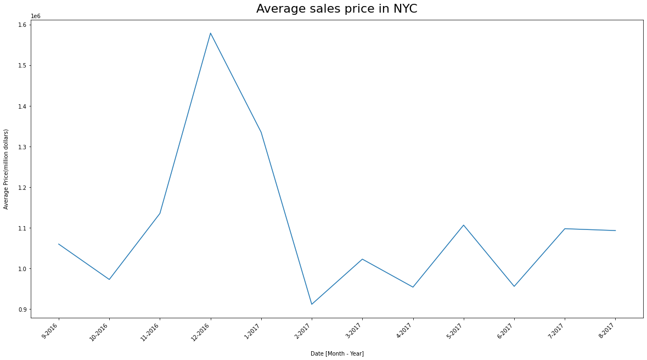
Trends in the Property Market
Property price increase from september to end of the year
Property price fluctuate in other month

Slide 8
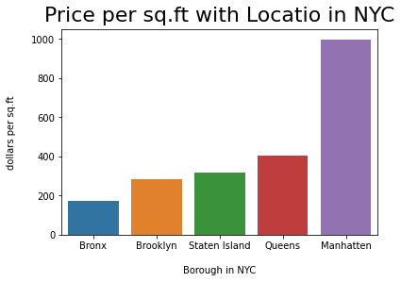

Location vs property sales price

Slide 9
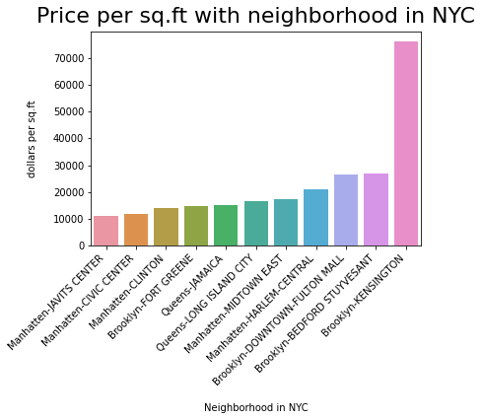
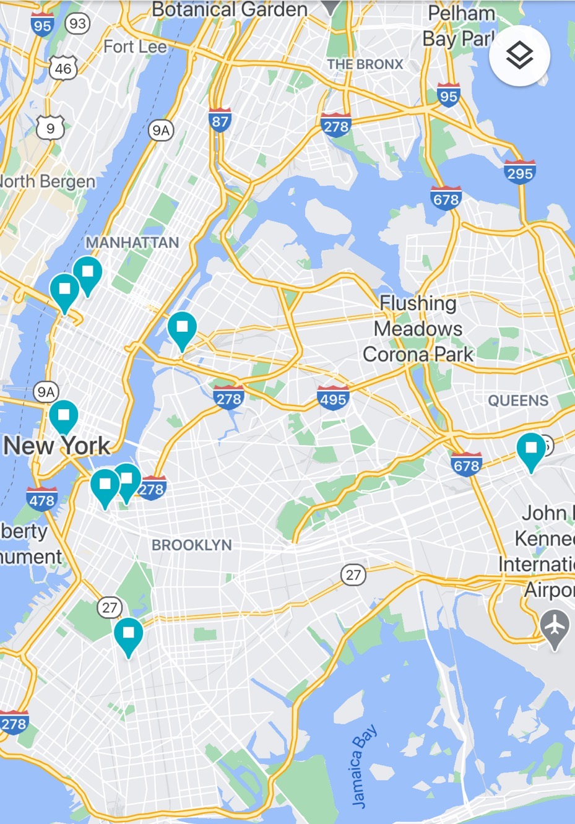
Distribution of top property sales price

Slide 10
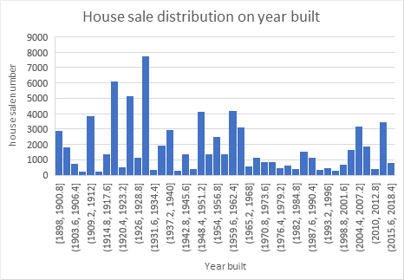
Preference on property age
Check which neighborhood may have relatively new or old property
Reference for buyers who have preference on property age.

Slide 11
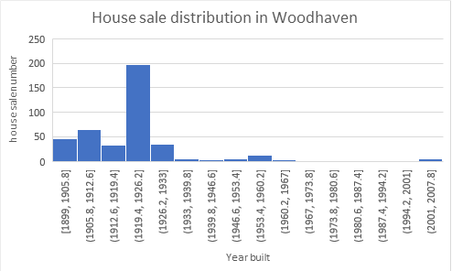
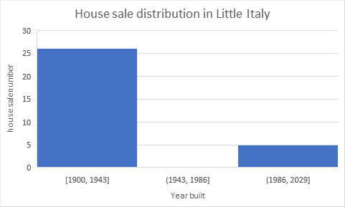
Example

Slide 12
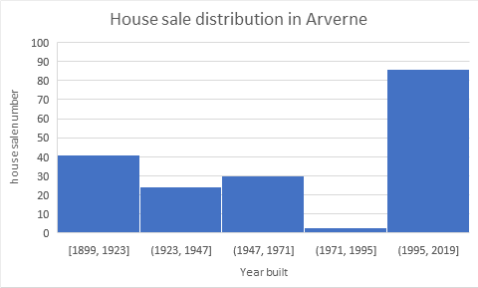
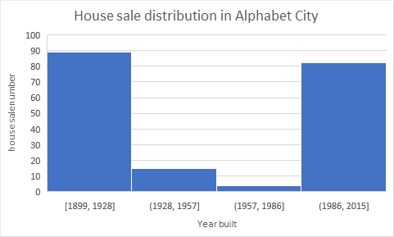
Example

Slide 13
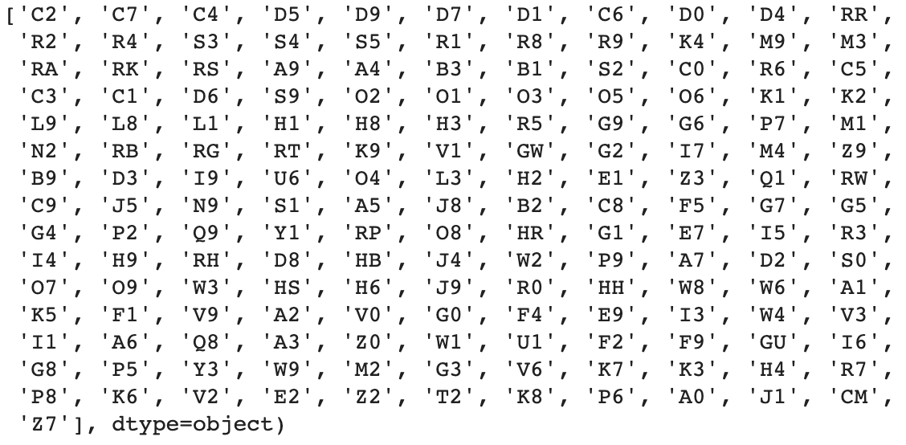
Type of building class
Total number of building class: 166
Type of building class at time of sale[2]:
Example of building class code and description:
C2: FIVE TO SIX FAMILIES
D5: ELEVATOR APT; CONVERTED
H5: HOTEL; PRIVATE CLUB, LUXURY TYPE
Notes:
We analyzed the relationship between sale price and building class. First let’s look at the analysis of building class. There are 166 different types of building class in total and they each consists of a letter and a number. The picture on the left shows the distinct types of building class in our project, and on the right there are three examples of building class code and description.

Slide 14
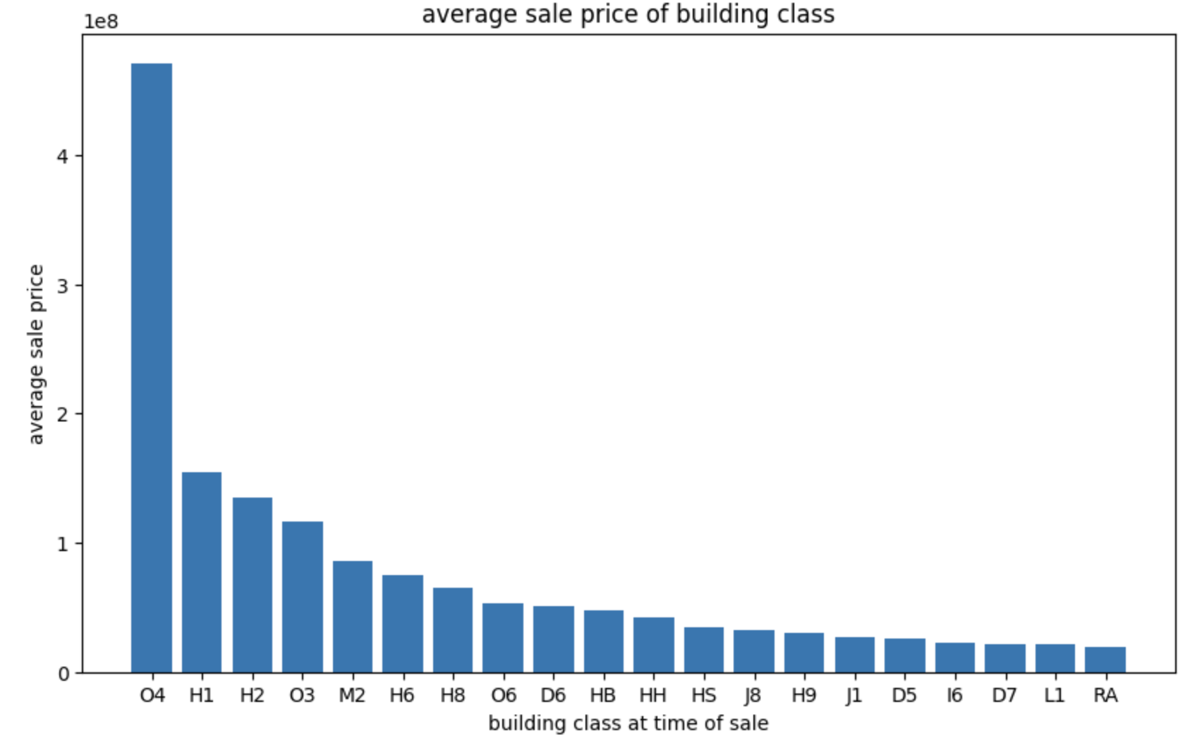
Average sale price vs. building class (top20)
Extremely right skewed
O4: OFFICE ONLY WITH OR WITHOUT COMM - 20 STORIES OR MORE
Notes:
Let’s look at the average sale price of each class. Since the price is extremely rights skewed, I took the top 20. The highest average price is O4, which refers to the office only with or without comm with 20 stories or more. The second and the third highest is H1 and H2, which represent luxury hotel and full service hotel. Follows by O3, which is office with 7 to 19 stories. For now we can conclude that the price of office building is far higher than other type, follows by luxury hotel.

Slide 15
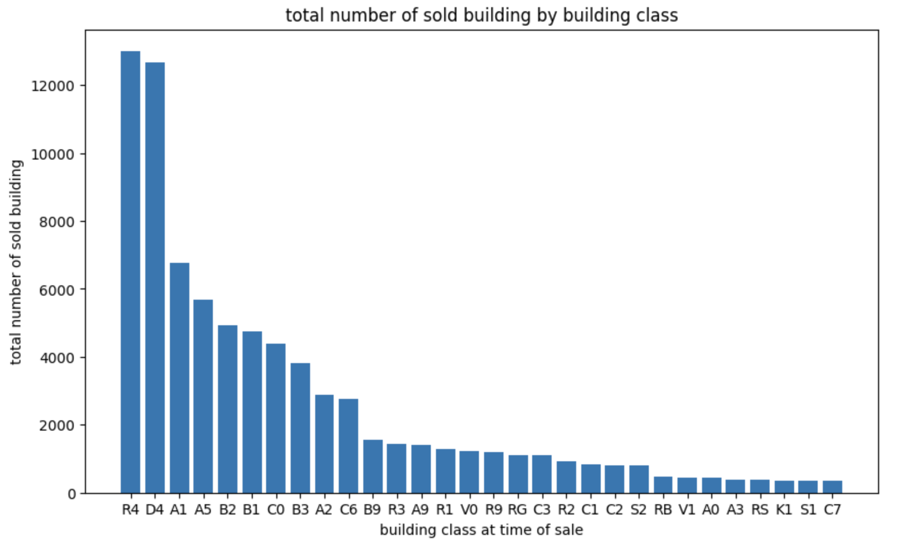
Total number of sold building group by building
class (top30)
Right skewed
Top 2: R4 (CONDO; RESIDENTIAL UNIT IN ELEVATOR BLDG.) and D4 (ELEVATOR COOPERATIVE)
Notes:
This is the distribution of building class for sold buildings. I took top 30 because this plot is right skewed as well. The type of the top two sold buildings are R4 and D4. R4 is condo, or residential unit in elevator buildings. D4 is elevator cooperative buildings. They were sold more than 12,000 in the last year. Follows by A1 and A5, which are two stories and one family attached or semi-detached. The third group is B2 and B1 which are two family frame and two family brick.

Slide 16
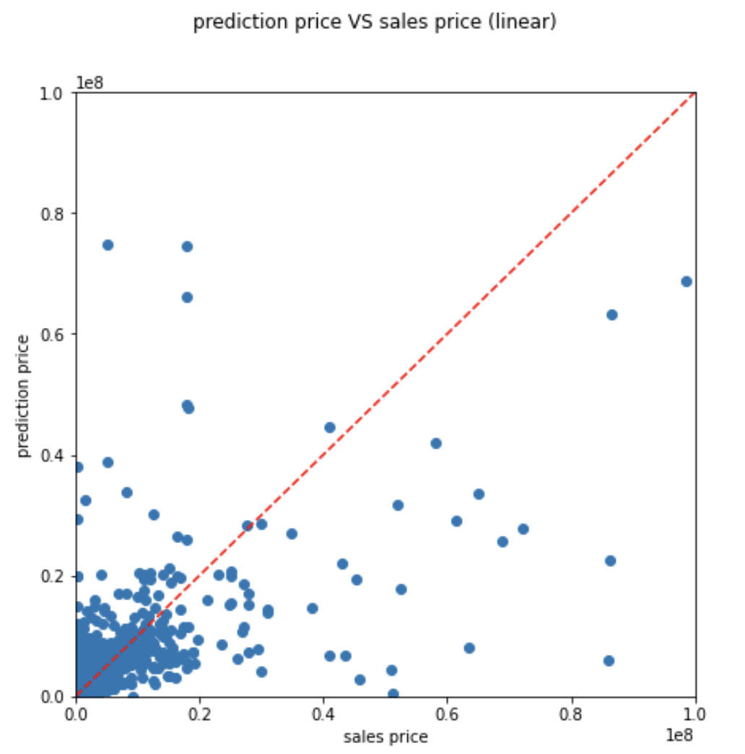
Linear Model
Mean Squared Error (MSE) = 1.6011e+14

Slide 17
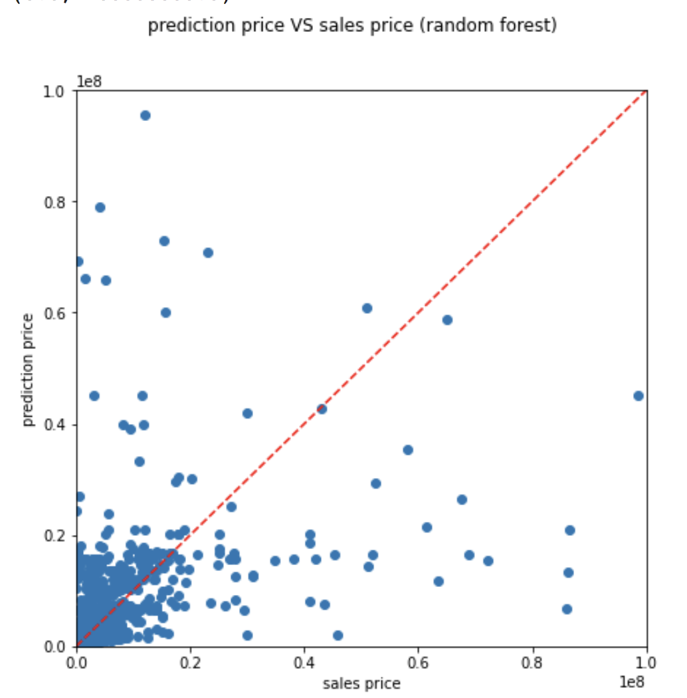
Random Forest
Mean Squared Error (MSE) = 6.07021e+13

Slide 18
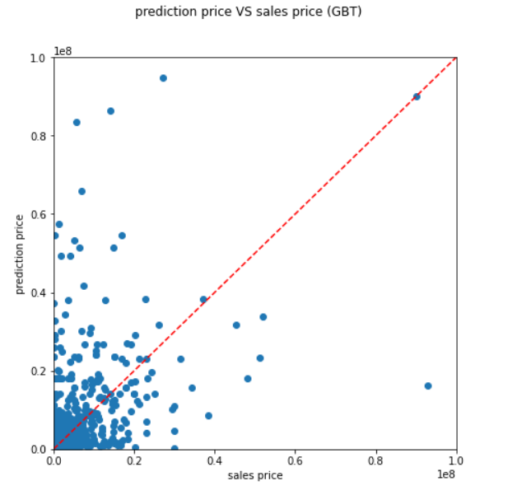
GBT(gradient boosted trees)
Mean Squared Error (MSE) = 1.004075e+6

Slide 19
Improvement
Try more columns as features columns and use feature importance
Transform nominal variables to dummy variables instead of simply using StringIndexer
Use grid search to create and train random forest and GBT to find the best values of parameters like numTrees, maxDepth, etc.
 | Linear | Random Forest | GBT
MSE | 1.6011e+14 | 6.07021e+13 | 1.004075e+6

Slide 20
Reference
[1]https://www.kaggle.com/new-york-city/nyc-property-sales?select=nyc-rolling-sales.csv
[2]https://www1.nyc.gov/assets/finance/jump/hlpbldgcode.html

